Slide 1
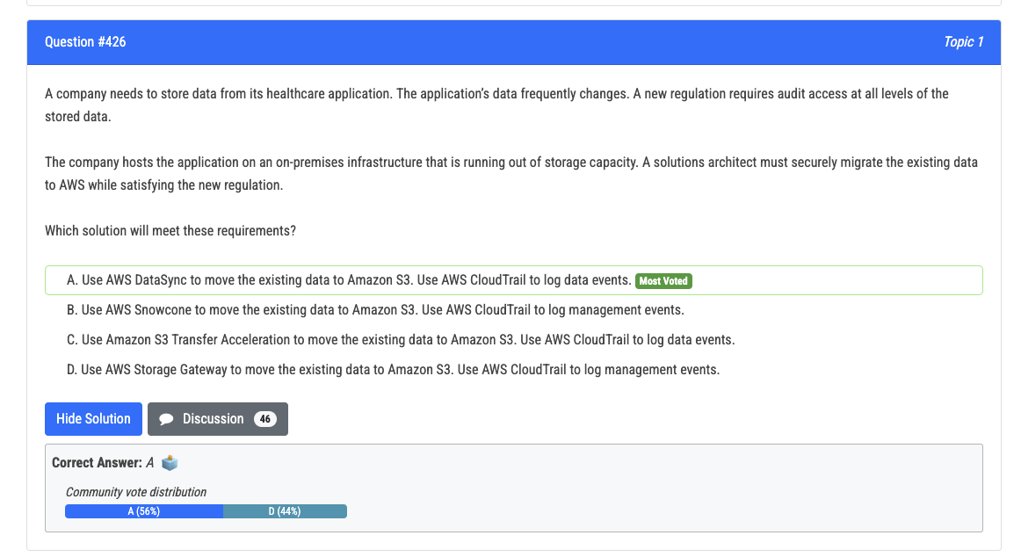
KEYWORD: Audit access to all levels of the stored data
Hence data event
Data event: Downloads an object from an S3 bucket, Uploads an object to an S3 bucket.
Management event: Creating or deleting an S3 bucket, Launching or terminating an EC2 instance.

Slide 2
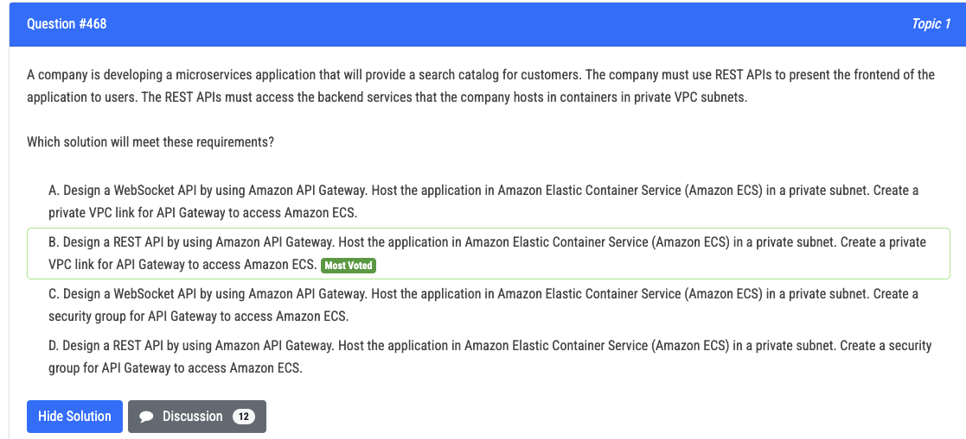
VPC Link for API Gateway to access ECS in private subnet
Access resources in private VPC in general
VPC Link Only Works with REST APIs and HTTP APIs:

Slide 3
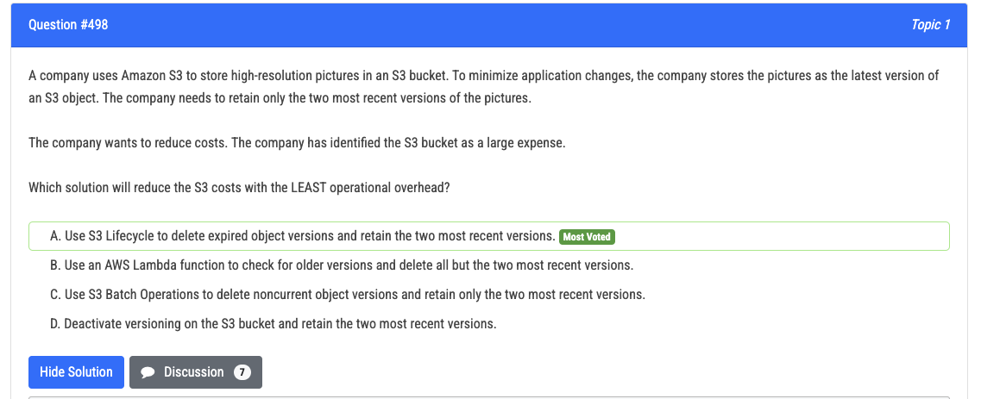
Use lifecycle policy to delete expired versions.

Slide 4
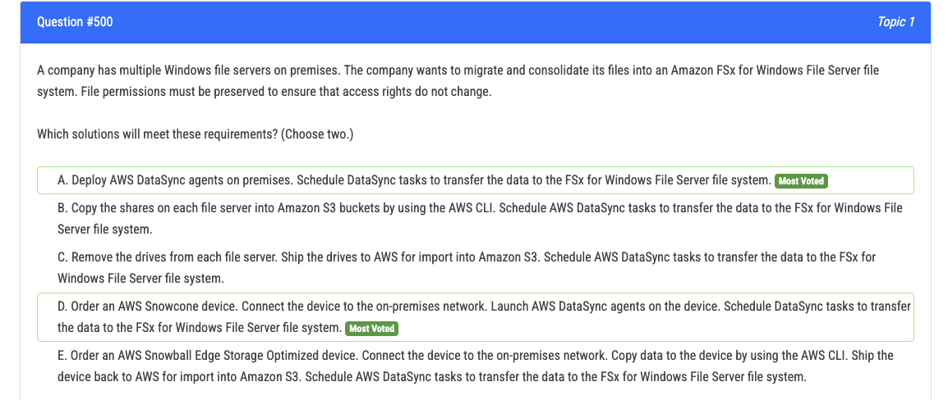
Preserve file permissions => DataSync
Copy with CLI loses the file permission
READ THE QUESTION, ITS “EITHER” NOT “IN COMBINATION”

Slide 5
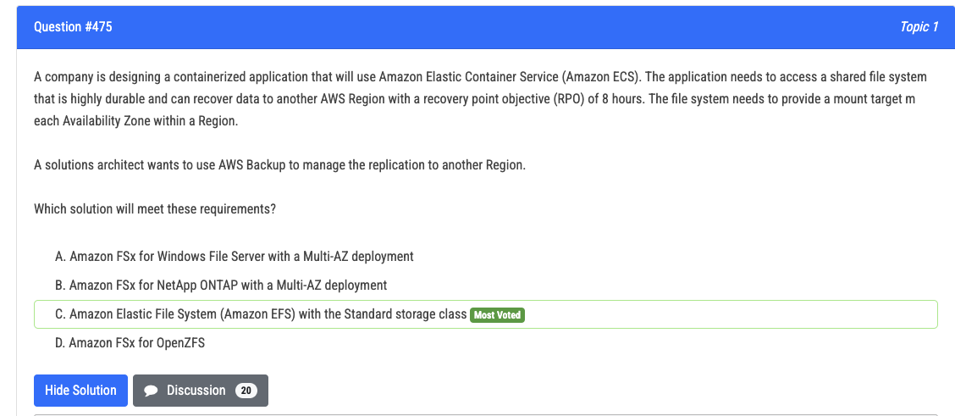

Slide 6
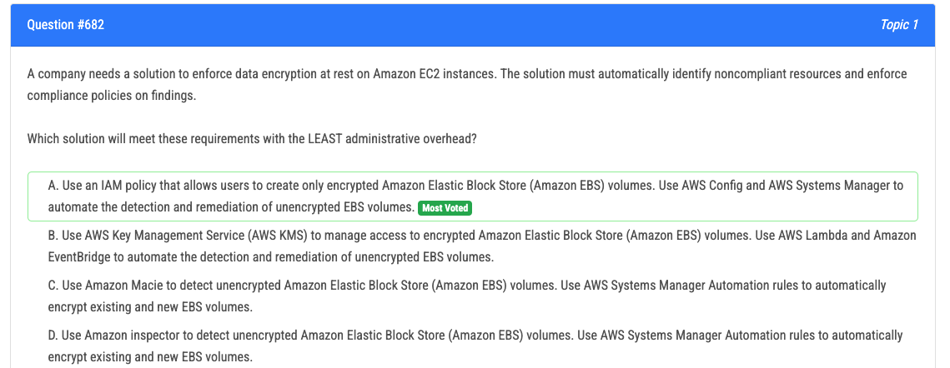

Slide 7
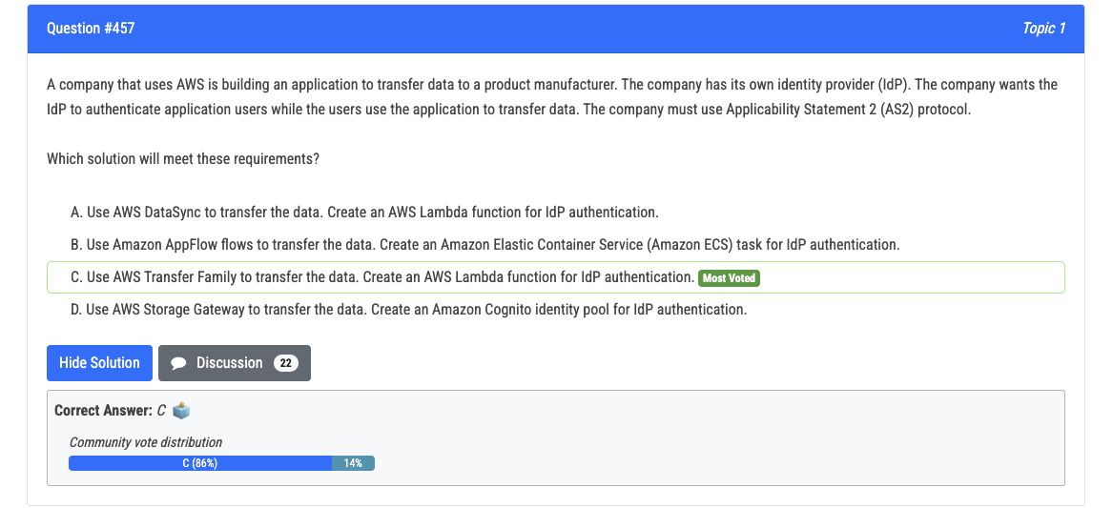

Slide 8
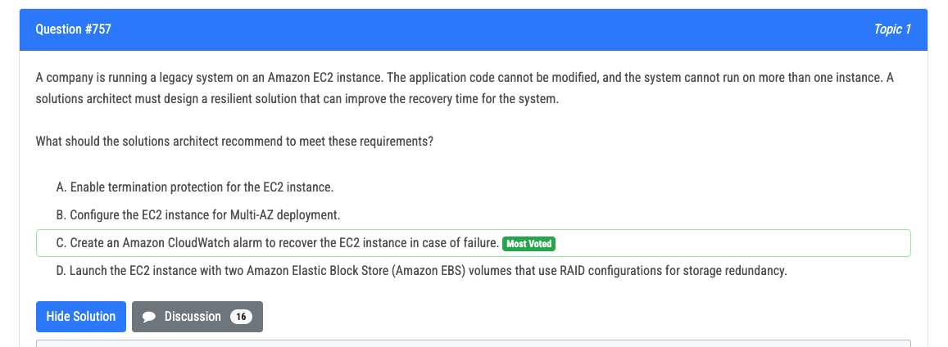

Slide 9
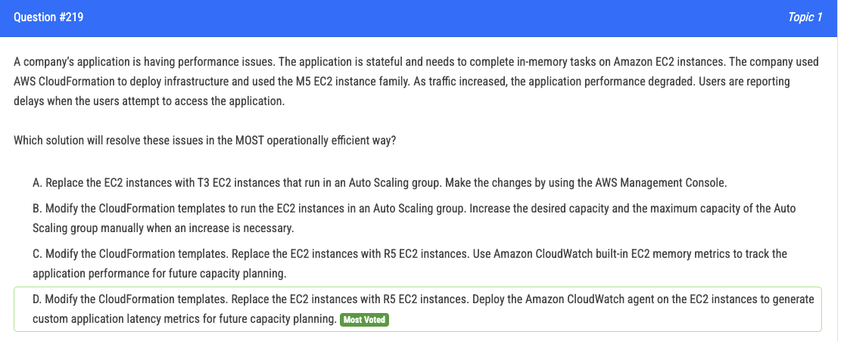
CloudWatch no memory metrics

Slide 10
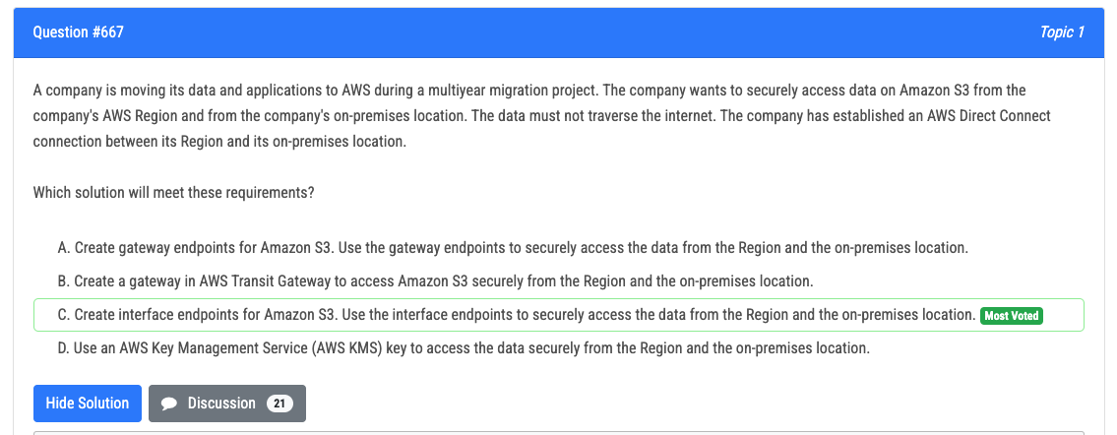
Gateway endpoints only for AWS.
On-Prem => Interface endpoint

Slide 11
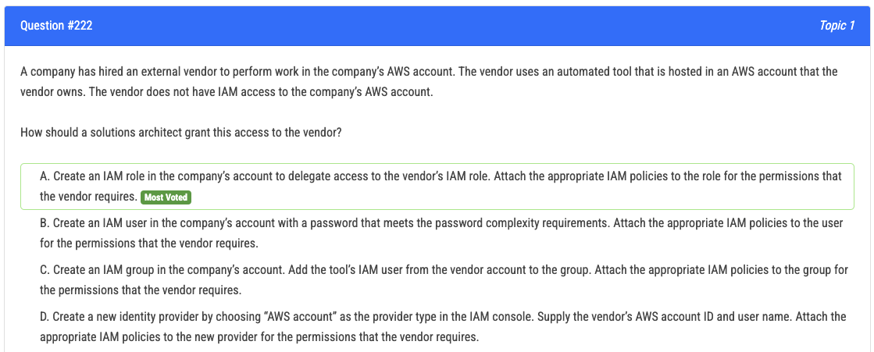
Delegate access => trust relationship

Slide 12
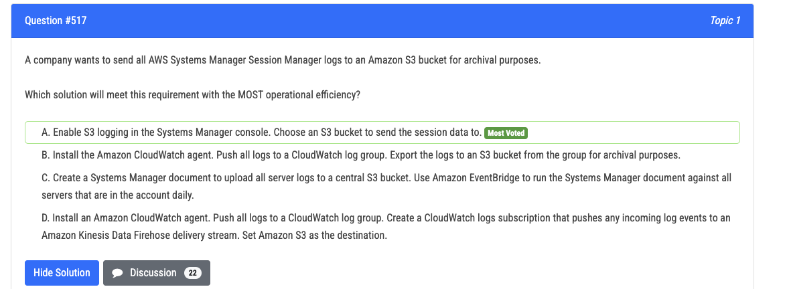

Slide 13
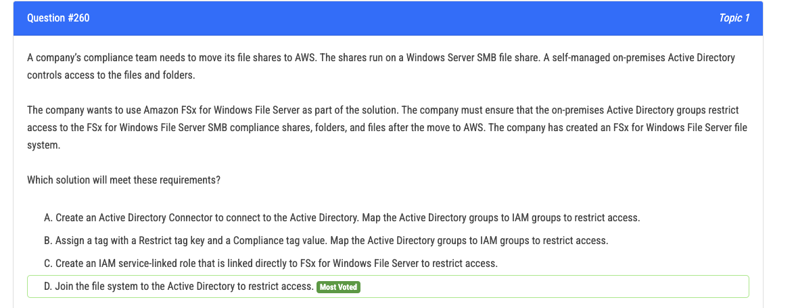

Slide 14
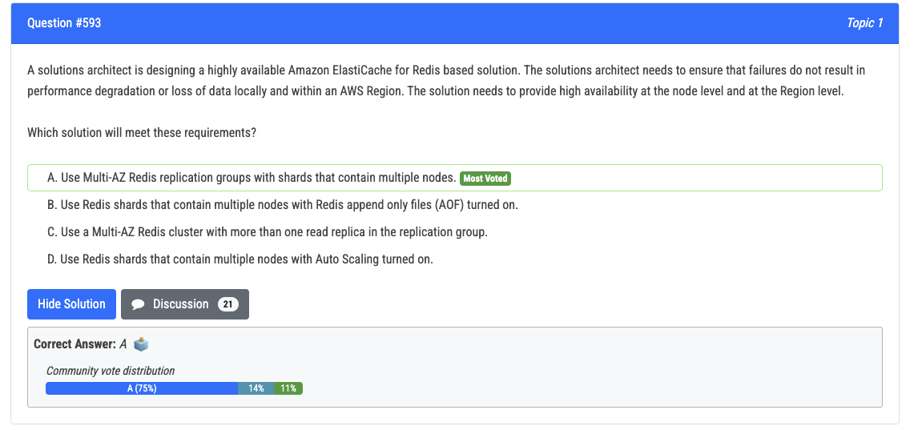
C good for read performance

Slide 15
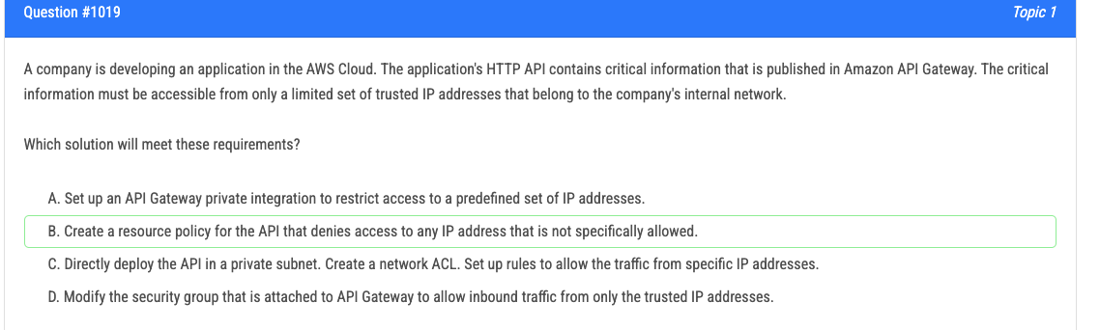
API Gateway doesn’t have security groups

Slide 16
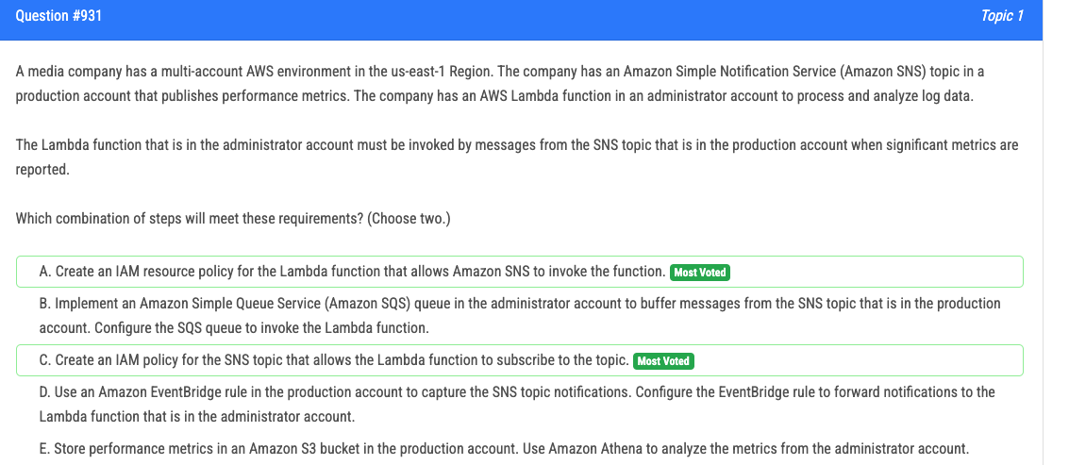

Slide 17
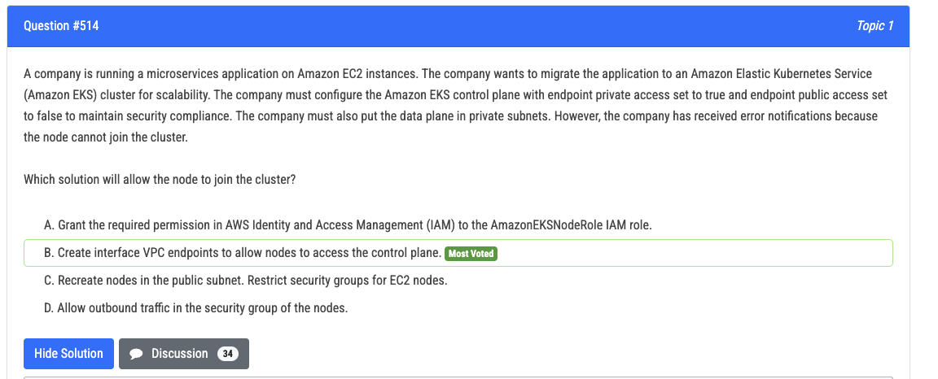

Slide 18
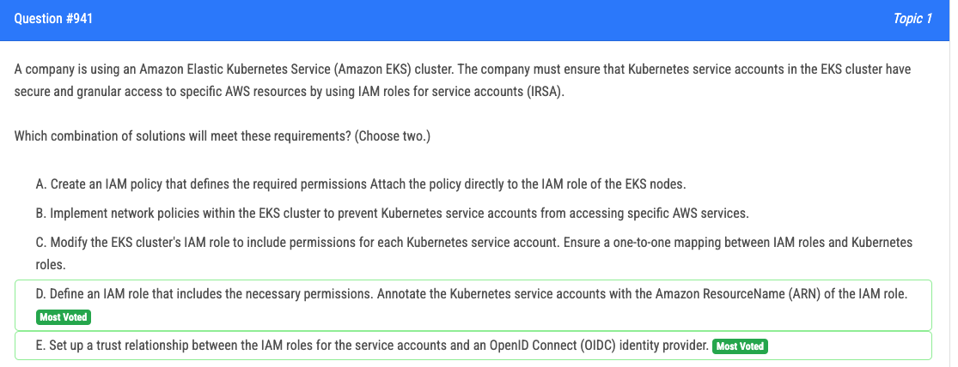

Slide 19
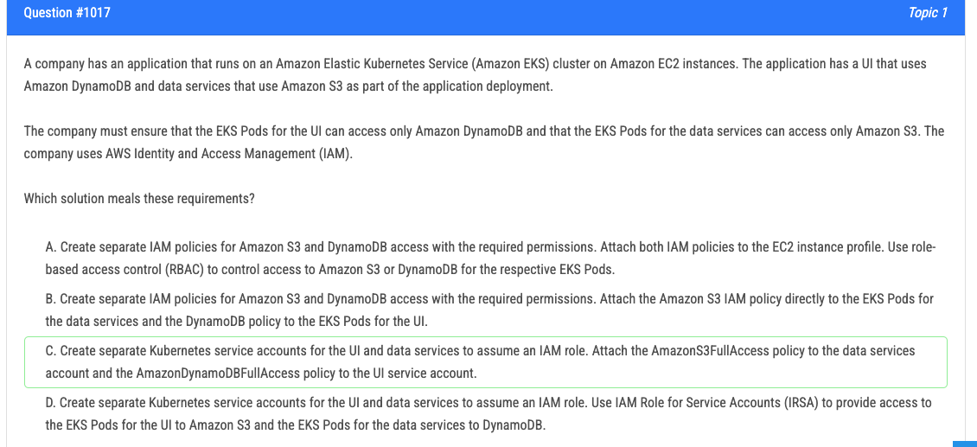
IAM policies cannot be directly attached to EKS Pods. The correct approach is to use IRSA
, where the IAM role associated with the Kubernetes service account assumes the necessary permissions.

Slide 20
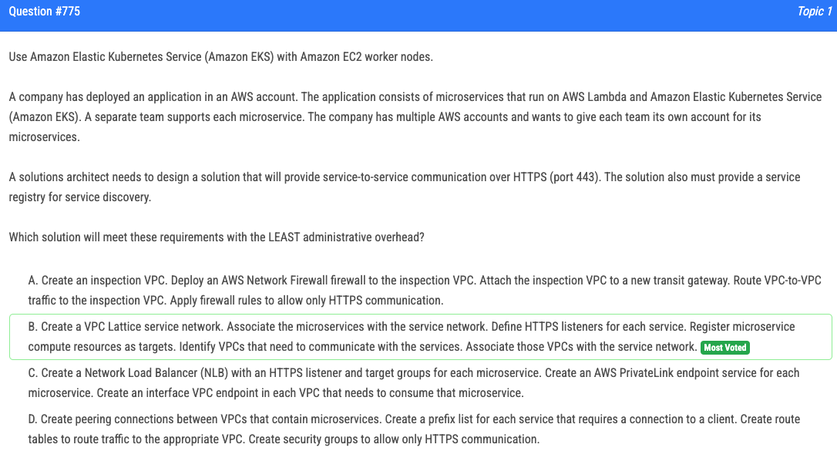

Slide 21
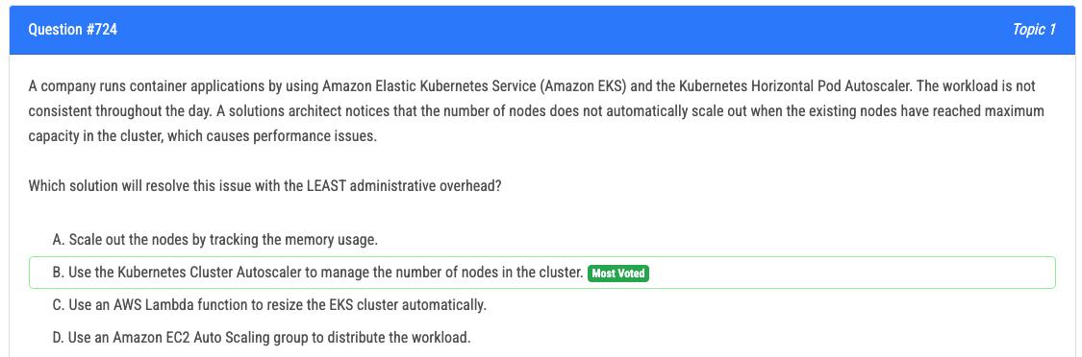

Slide 22
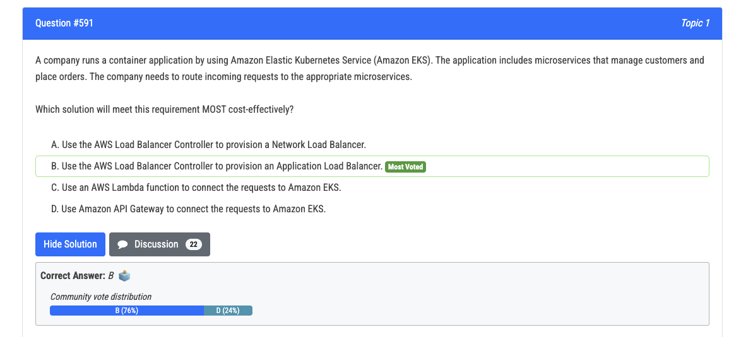

Slide 23
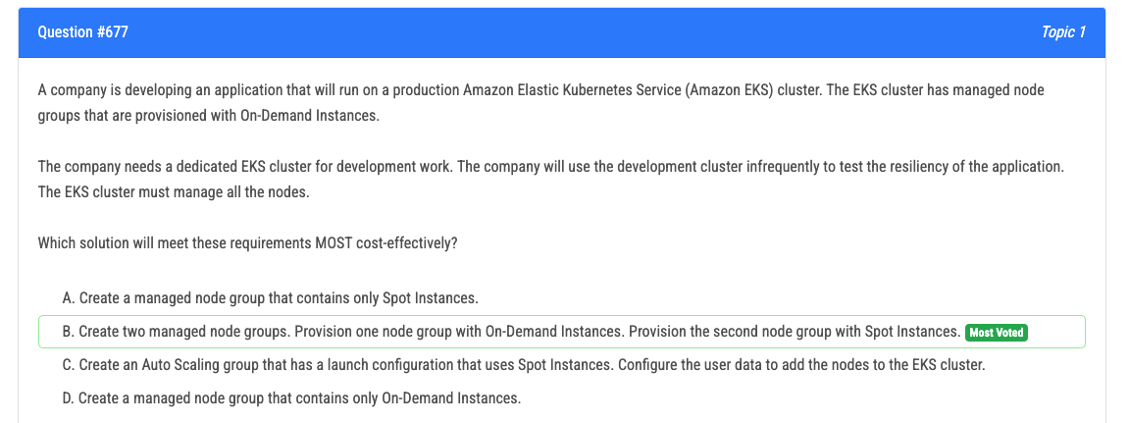

Slide 24
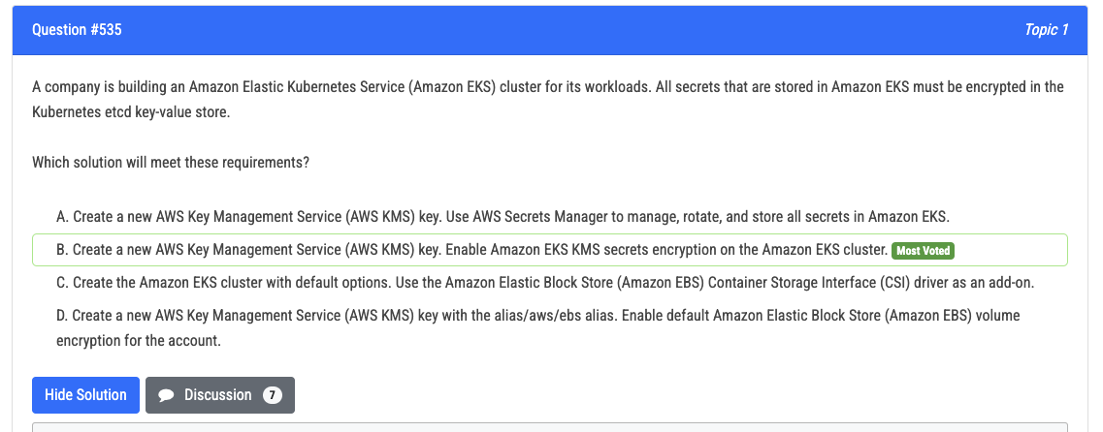

Slide 25
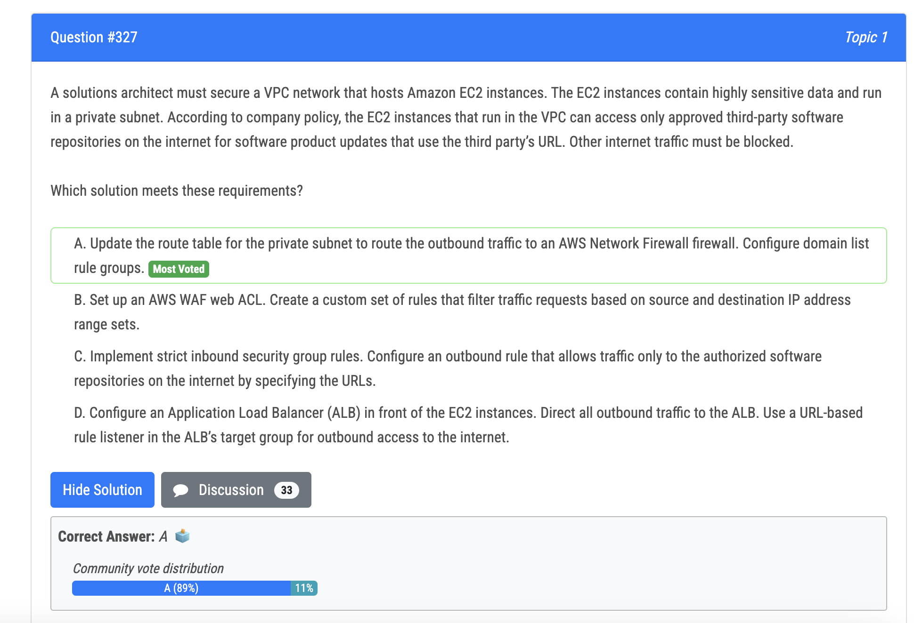
WAF doesn’t control outbound traffic.

Slide 26
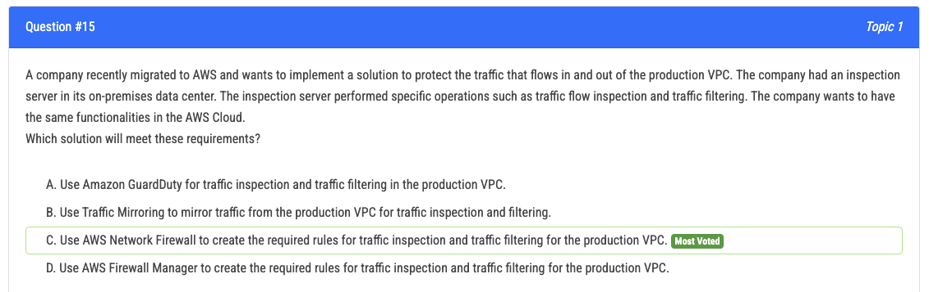

Slide 27
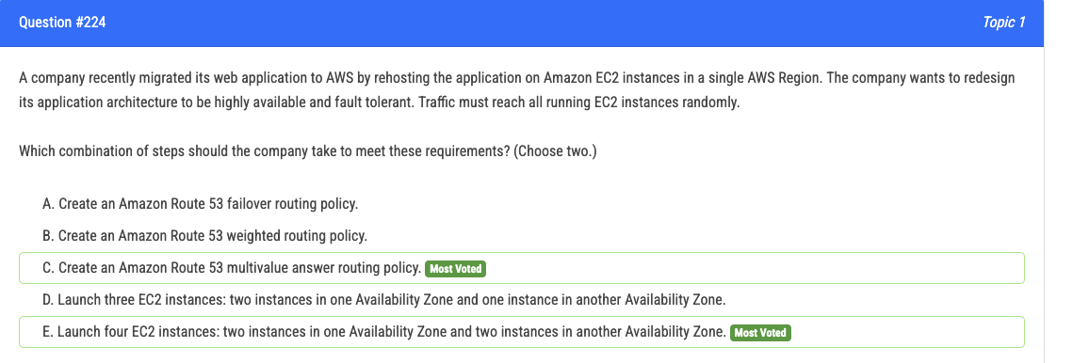

Slide 28
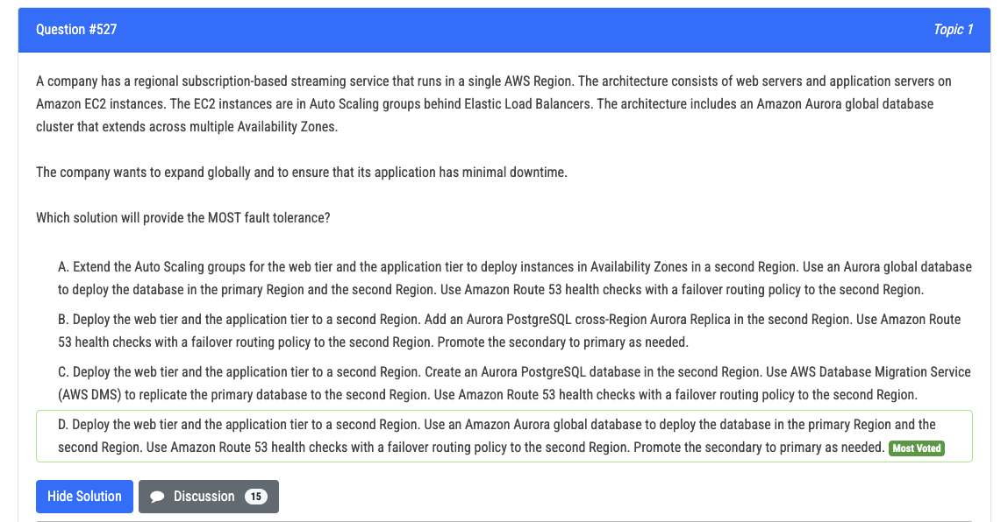
Auto-scaling is regional construct

Slide 29
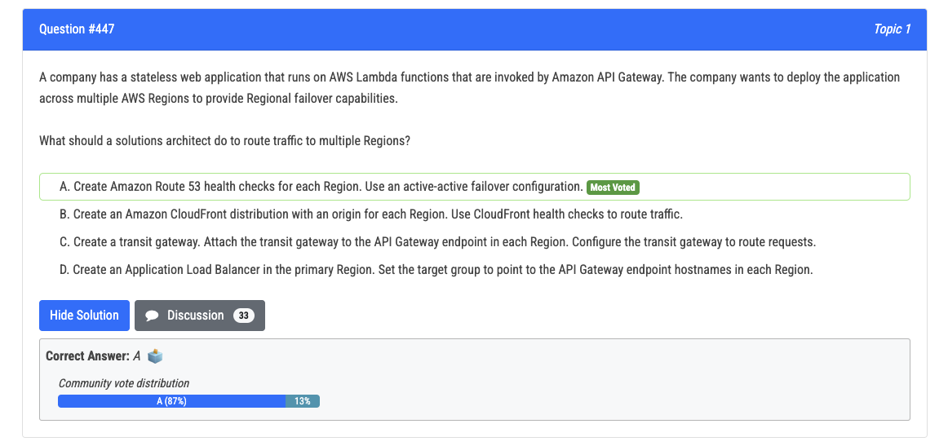
Global, Reduce latency, health checks, no failover = Amazon CloudFront
Global ,Reduce latency, health checks, failover, Route traffic = Amazon Route 53
ALB cannot operate across region

Slide 30
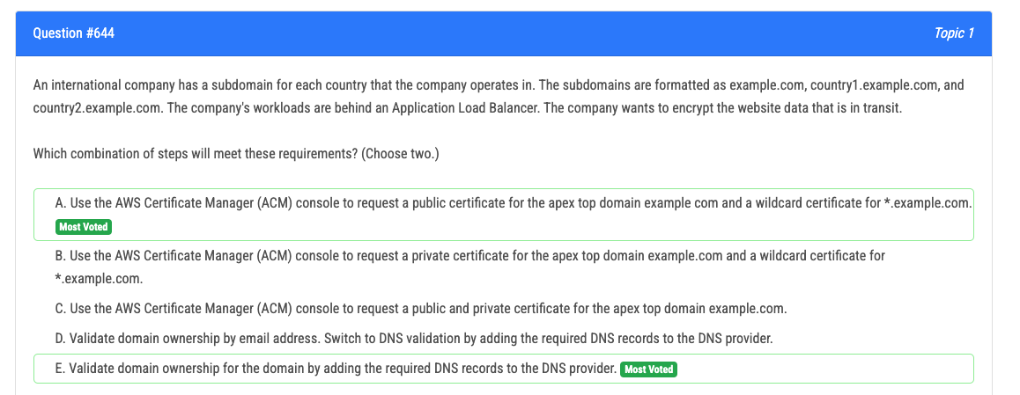

Slide 31
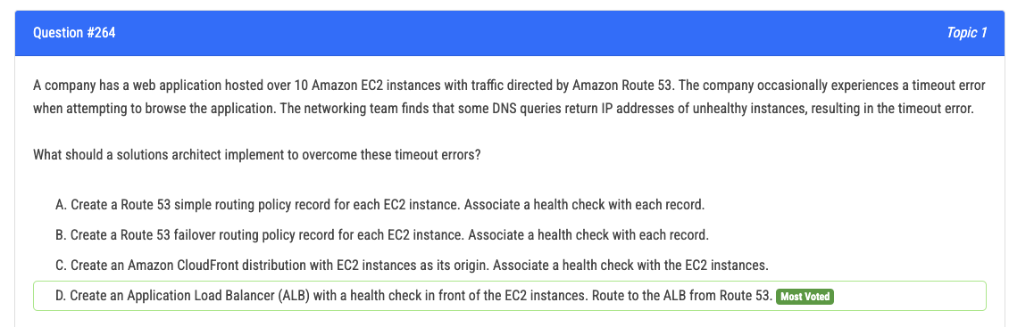
Generally, Route 53 is not good for traffic distribution to
Many instances

Slide 32
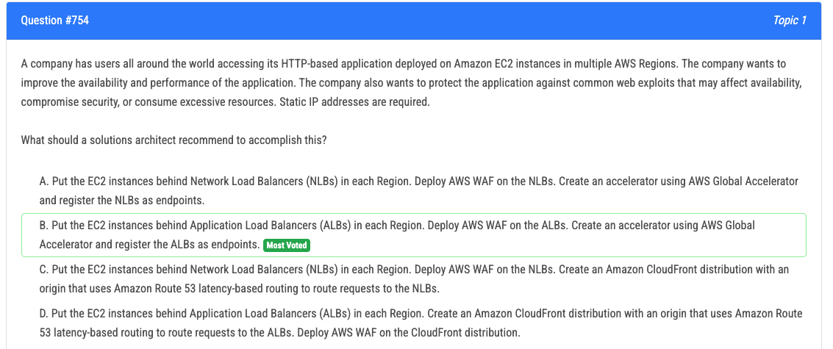

Slide 33
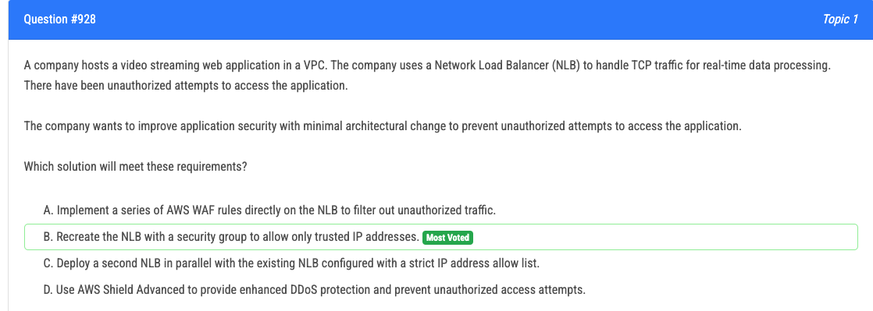
DDoS overwhelms, only WAF and Sield
Unauthorised => MFA, password, IAM, firewall
WAF Cannot work on NLB

Slide 34
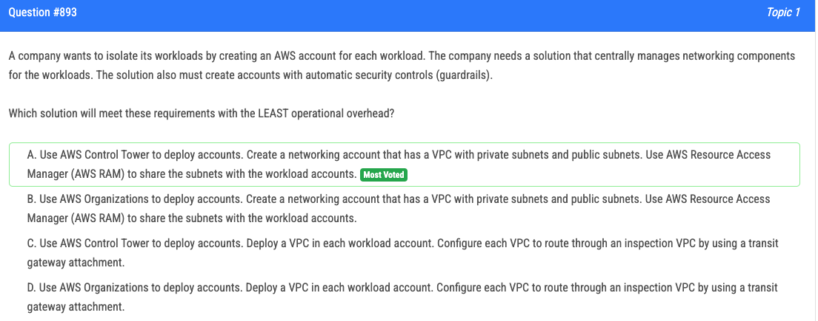

Slide 35
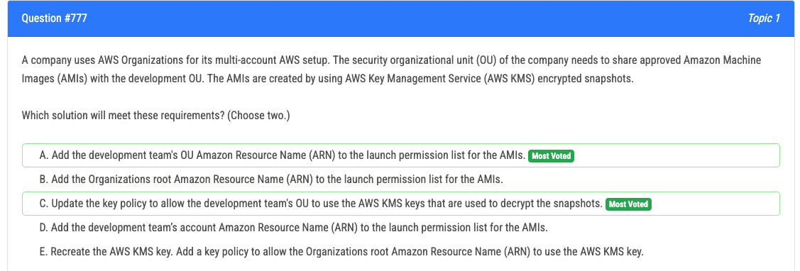

Slide 36
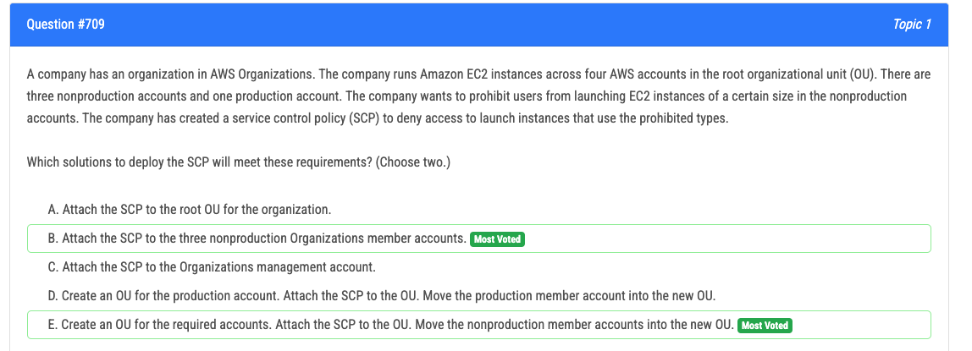
IT’S EITHER OR, NOT TOGEHER. Read the question.

Slide 37
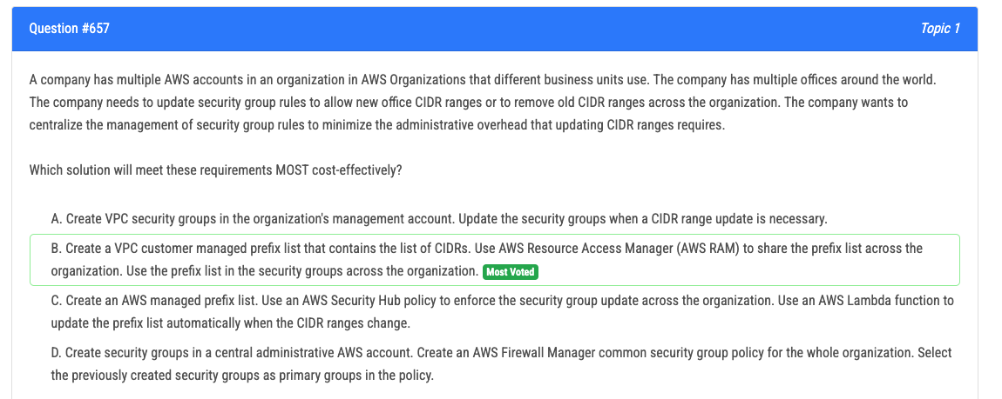

Slide 38
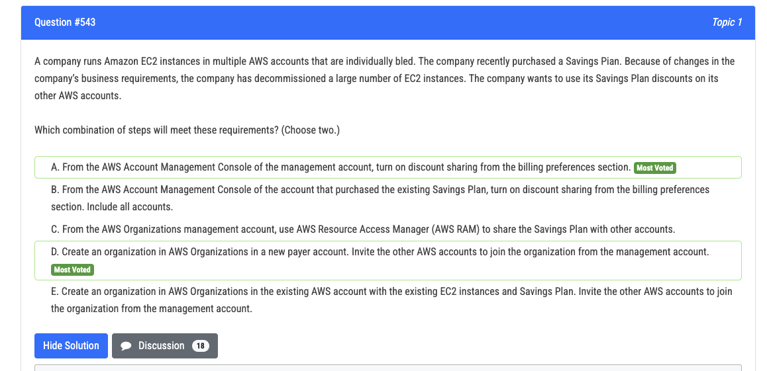
E involves setting up the organization from the existing account with the Savings Plan,
which may not be the best practice if the company wants to separate billing management from operational accounts.

Slide 39
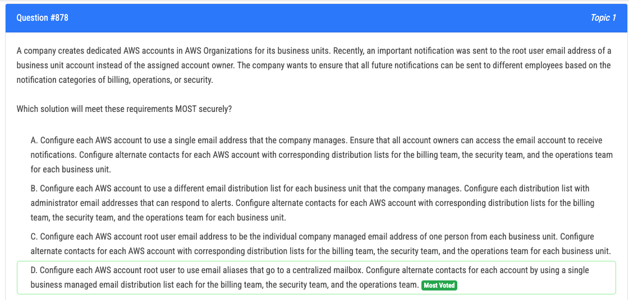

Slide 40
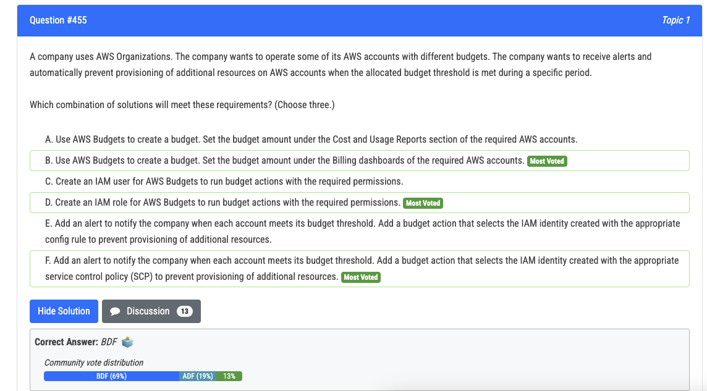

Slide 41
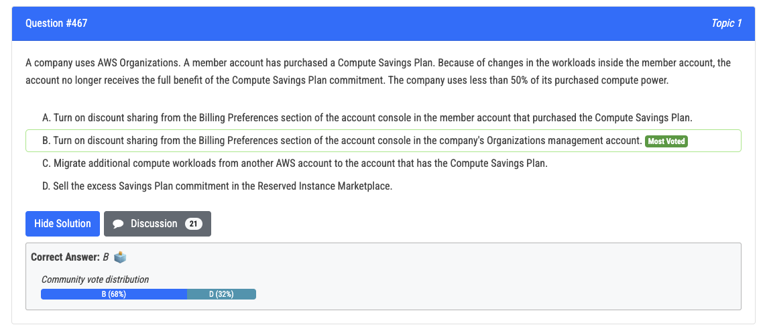

Slide 42
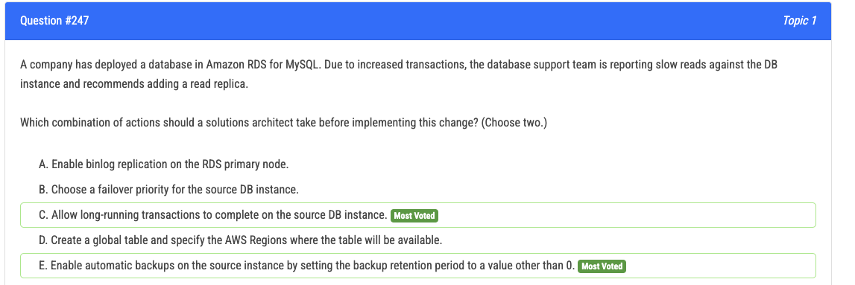

Slide 43
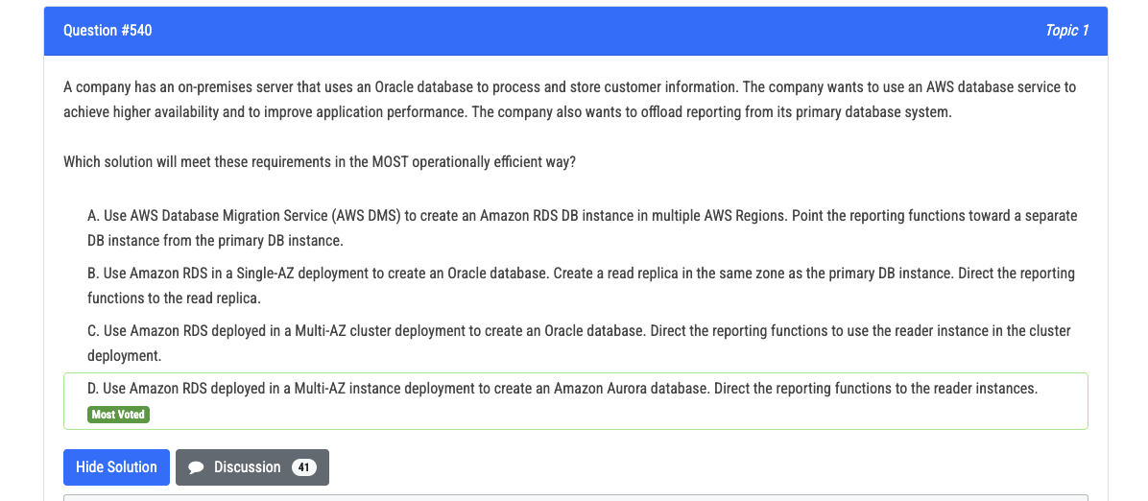
Multi-AZ DB clusters aren't available with the following engines:
RDS for MariaDB RDS for Oracle RDS for SQL Server

Slide 44
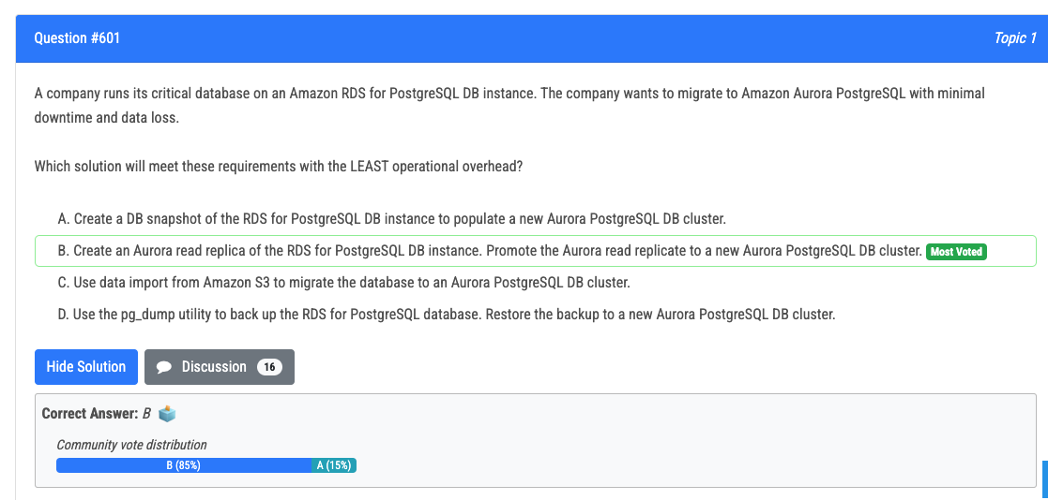

Slide 45
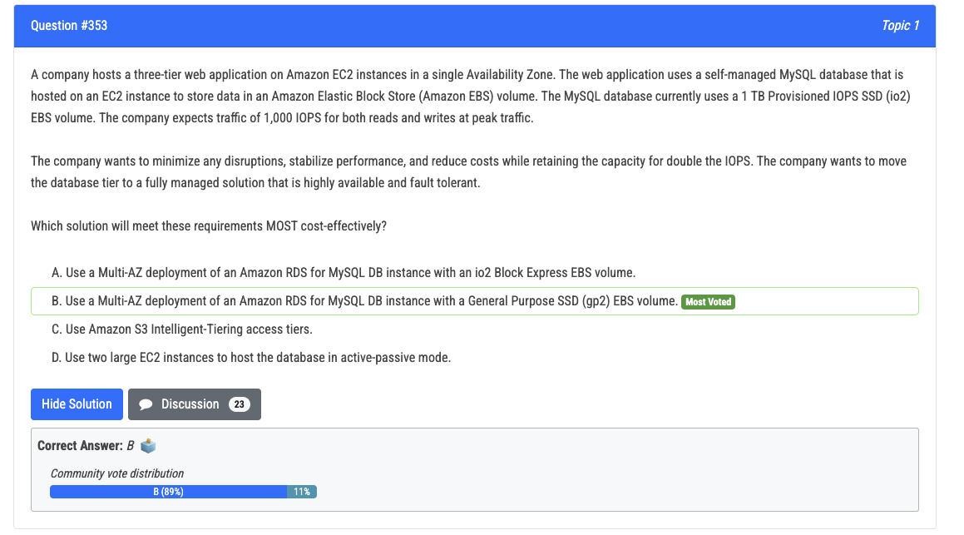

Slide 46
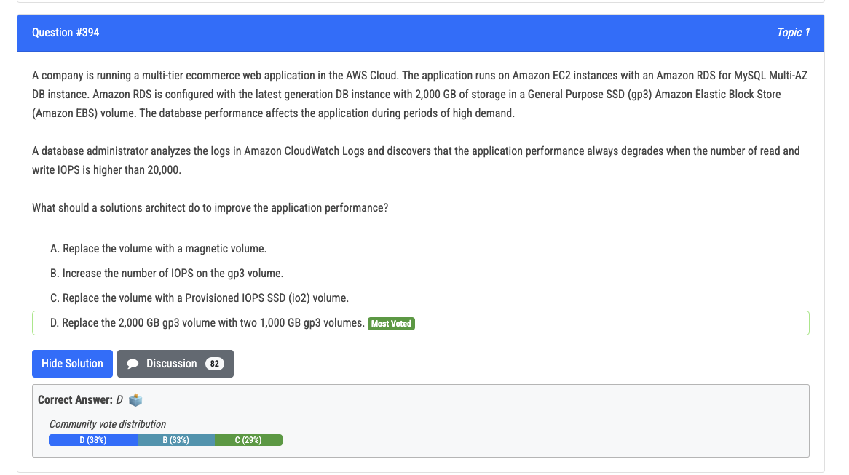
GP3 is cheaper than iO2, supports up to16000 IOPS

Slide 47
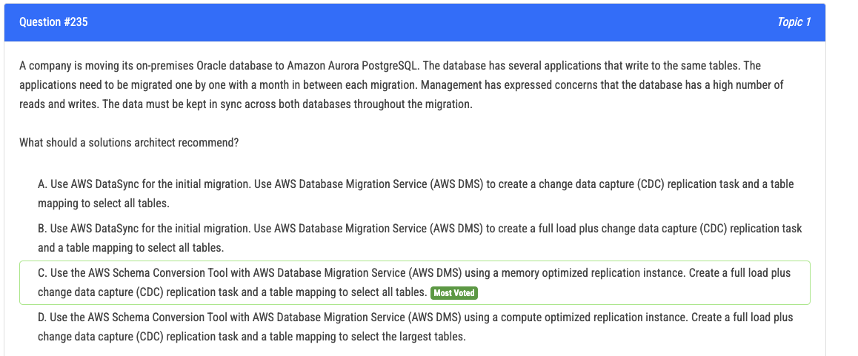
High read write => memory optimiseds

Slide 48
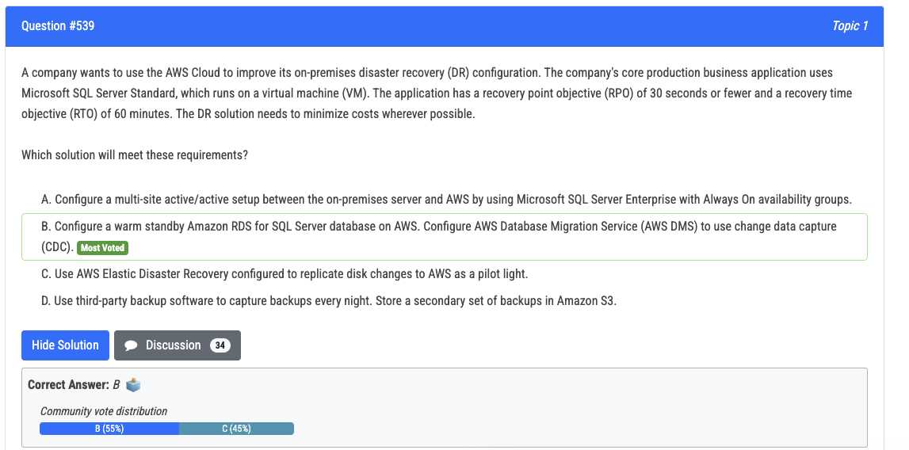

Slide 49
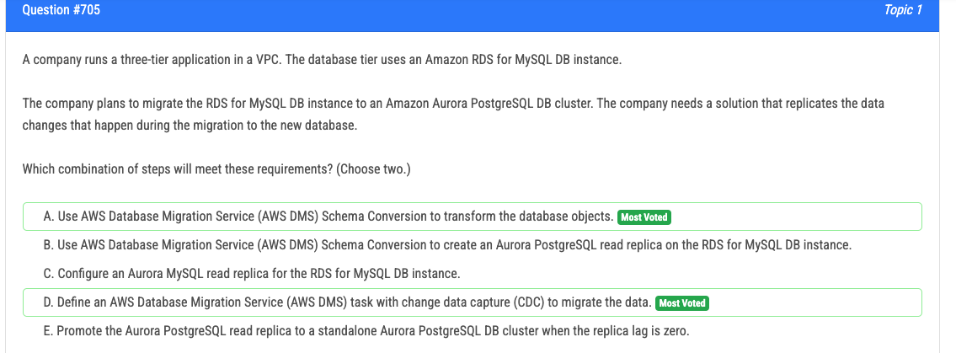
DMS cannot CREATE DB INSTANCE

Slide 50
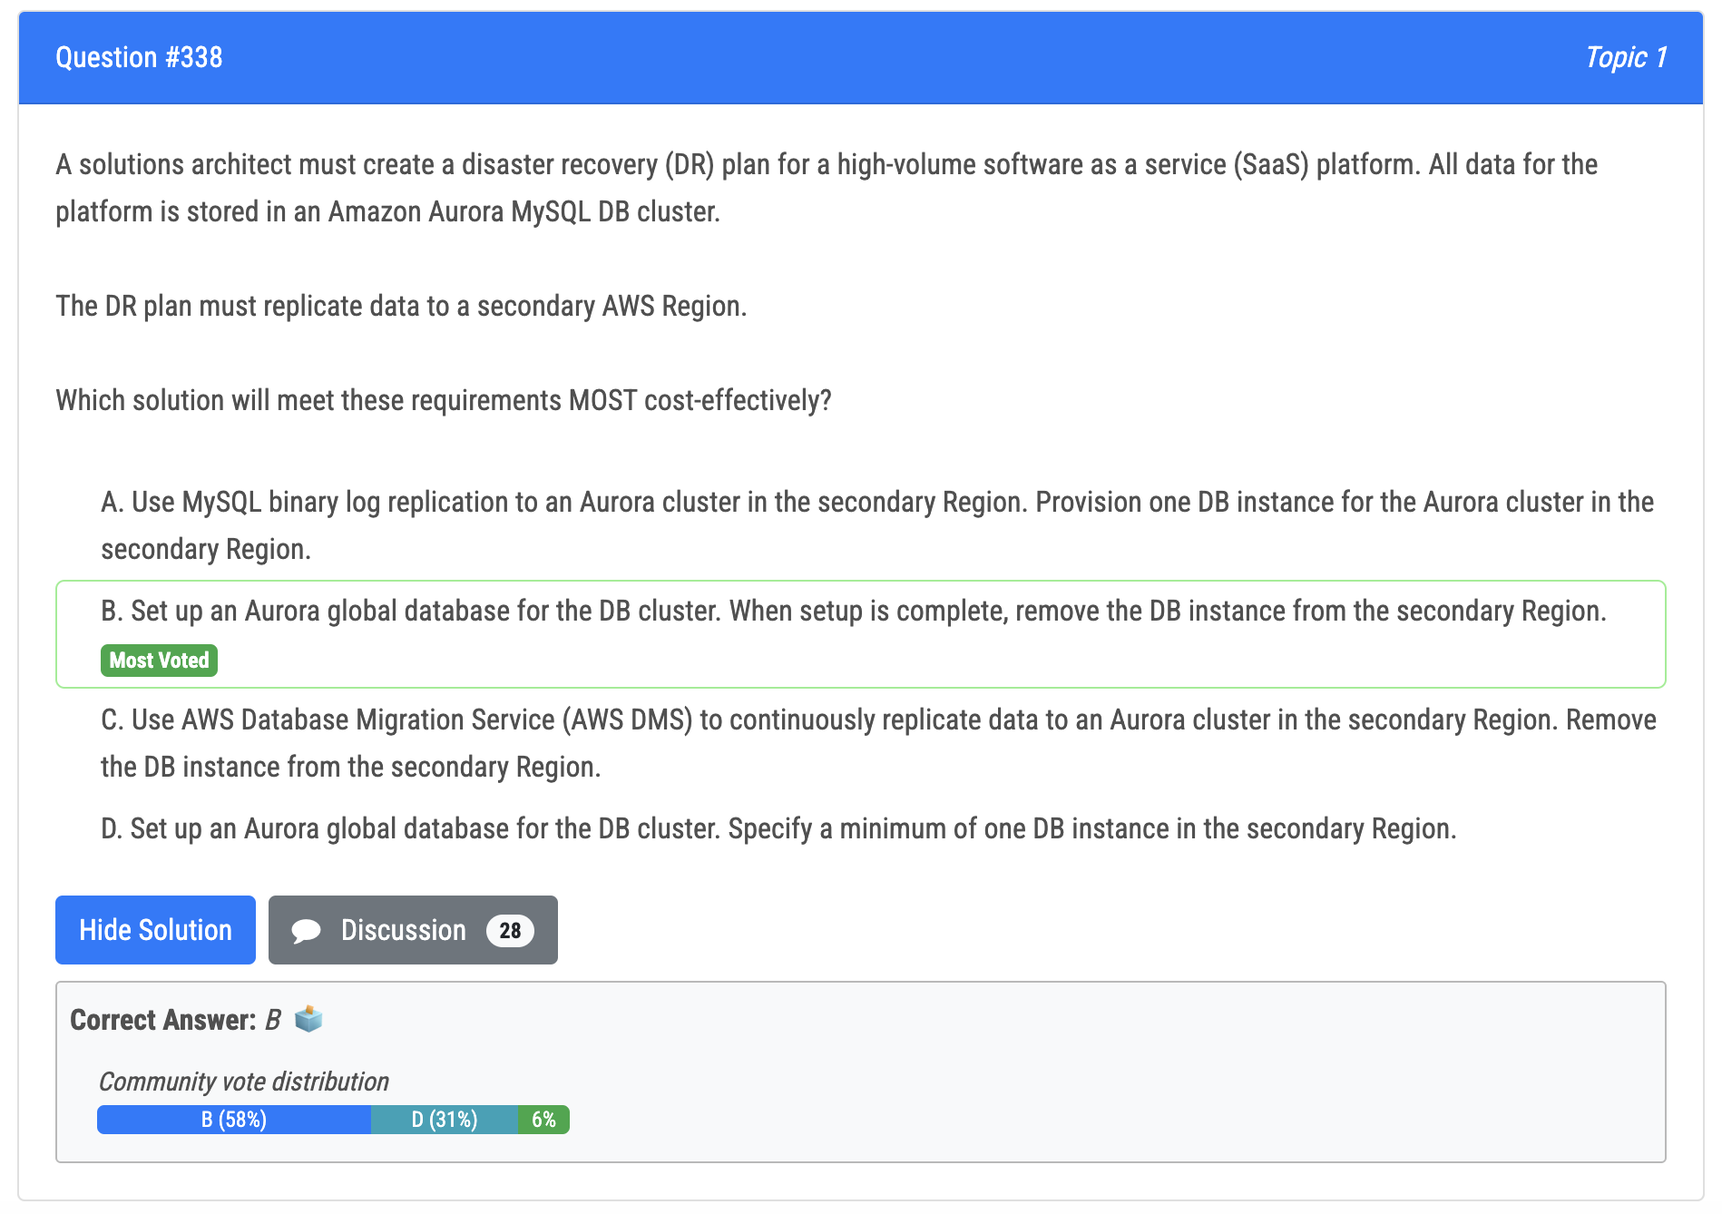

Slide 51

Most flexible, monetary commitment
Everything fixed except sizes
Reserved Instance: type, family, size all fixed for 1 -3 years, max savings
Can change the region using the Reserved Instance Marketplace
Convertible RI: can change family, os or tenancy
CANNOT CHANGE REGION

Slide 52

C doesn’t mention server-side encryption using KMS
A is not correct because it does not refer to KMS
Generally only SQS needs to specify TLS

Slide 53

Default TTL applies only when your origin does not add HTTP headers such as Cache-Control max-age, Cache-Control s-maxage, or Expires to objects."
C - Cache-Control private directive specifies that the response is intended for a single user and should not be cached by shared caches - it can still be cached, but only on a client device.

Slide 54


Slide 55


Slide 56


Slide 57

Sticky sessions on ALB isn’t persistent

Slide 58


Slide 59

NACL is on subnet level

Slide 60


Slide 61


Slide 62


Slide 63


Slide 64


Slide 65


Slide 66


Slide 67

A, D

Slide 68


Slide 69


Slide 70


Slide 71


Slide 72


Slide 73


Slide 74


Slide 75


Slide 76


Slide 77


Slide 78


Slide 79


Slide 80


Slide 81


Slide 82


Slide 83


Slide 84


Slide 85

B or D, I prefer D.
Gut feeling is B

Slide 86


Slide 87


